Slide 1



Introduction to
OSHA Standards

Slide 2

Code of Federal Regulations (CFR)
A system of organization for the rules published in the Federal Register
The CFR is divided into 50 titles which cover broad areas subject to Federal regulation

Slide 3

Code of Federal Regulations
The Code of Federal Regulations is updated annually to incorporate revisions and new regulations
      Titles 1-16 are updated as of January 1st
      Titles 17-27 are updated as of April 1st
      Titles 28-41 are updated as of July 1st
      Titles 42-50 are updated as of October 1st
OSHA (Title 29) regulations are updated each July 1st

Slide 4
Code of Federal Regulations
Each title is divided into chapters, which usually bear the name of the issuing agency.
Each chapter is further subdivided into parts that cover specific regulatory areas.
Large parts may be subdivided into subparts.
A list of agencies and where they appear in the CFR may be found in Appendix C of the U.S. Government Manual

Slide 5

Department of Labor (DOL)
The purpose of the Department of Labor shall be to:
  Foster, promote, and develop the welfare of the wage earners of the United States,
  To improve their working conditions, and
  To advance their opportunities for profitable employment.

Slide 6
Title 29; Chapter 12; Section 553
There are established in the Department of Labor nine offices of Assistant Secretary of Labor, which shall be filled by appointment by the President, by and with the advice and consent of the Senate.
Each of the Assistant Secretaries of Labor shall perform such duties as may be prescribed by the Secretary of Labor or required by law.
One of such Assistant Secretaries shall be an Assistant Secretary of Labor for Occupational Safety and Health

Slide 7
Occupational Safety and Health Administration
The Administration, headed by the Assistant Secretary for Occupational Safety and Health, sets and enforces workplace safety and health standards and assists employers in complying with those standards.
The Occupational Safety and Health Administration (OSHA), created pursuant to the Occupational Safety and Health Act of 1970 (29 U.S.C. 651 et seq.),

Slide 8
Occupational Safety and Health Administration
OSHA has established a four-fold focus:
  Firm and fair enforcement of safety and health rules;
  Partnership with States running their own OSHA- approved programs and with employers and employees interested in developing effective workplace safety and health programs;
  Efficient promulgation of new rules that are clear and easy to understand and follow; and
  Increased outreach and training to help employers and employees eliminate safety and health hazards.

Slide 9
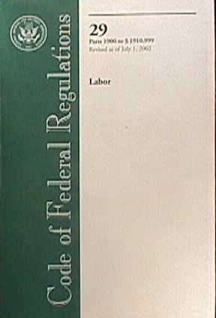
Code of Federal Regulations
Each chapter is further subdivided into parts that cover specific regulatory areas
Large parts may be subdivided into subparts

Slide 10
Code of Federal Regulations (CFR)
Some parts within Title 29 that we should know include:
Part 1903 INSPECTIONS, CITATIONS AND PROPOSED PENALTIES
Part 1904 RECORDING AND REPORTING OCCUPATIONAL INJURIES AND ILLNESSES
Part 1910 OCCUPATIONAL SAFETY AND HEALTH STANDARDS

Slide 11

Origin of OSHA Standards - 1910.1 Purpose and Scope
The Secretary shall, beginning with the effective date of this Act and ending 2 years after, promulgate as an occupational safety or health standard:
  Any national consensus standard, and
  Any established Federal standard,
Unless he determines that such a standard would not result in improved safety or health for specifically designated employees."

Slide 12

Origin of OSHA Standards - 1910.1 Purpose and Scope
The legislative purpose of this provision is to establish, as rapidly as possible and without regard to the rule-making provisions of the Administrative Procedure Act:
  Standards with which industries are generally familiar, and
  On whose adoption interested and affected persons have already had an opportunity to express their views.

Slide 13

Origin of OSHA Standards - 1910.1 Purpose and Scope
Such standards are either:
(1) National consensus standards on whose adoption affected persons have reached substantial agreement, or
(2) Federal standards already established by Federal statutes or regulations

Slide 14

Federal Safety and Health Standards
"Standard" means a standard which requires conditions, or the adoption or use of one or more:
  Practices,
  Means,
  Methods,
  Operations, or
  Processes, reasonably necessary to provide safe or healthful employment and places of employment;

Slide 15

National Consensus Standard
"National consensus standard" means any standard or modification thereof which:
  (1) Has been adopted and promulgated by a nationally recognized standards-producing organization under procedures whereby it can be determined by the Secretary of Labor or by the Assistant Secretary of Labor that persons interested and affected by the scope or provisions of the standard have reached substantial agreement on its adoption

Slide 16

National Consensus Standard
"National consensus standard" means any standard or modification thereof which:
  (2) Was formulated in a manner which afforded an opportunity for diverse views to be considered, and
  (3) Has been designated as such a standard by the Secretary or the Assistant Secretary, after consultation with other appropriate Federal agencies; and

Slide 17

Established Federal Standard
"Established Federal standard" means any operative standard established by any agency of the United States and in effect on April 28, 1971, or contained in any Act of Congress in force on the date of enactment of the Williams-Steiger Occupational Safety and Health Act.

Slide 18

Horizontal and Vertical Standards
Some standards are horizontal meaning “general”, or “across the board”
Horizontal standards could apply to any employer in any industry
Examples of horizontal standards include the Hazard Communication Standard which cover the safe use of chemicals by workers who use them

Slide 19
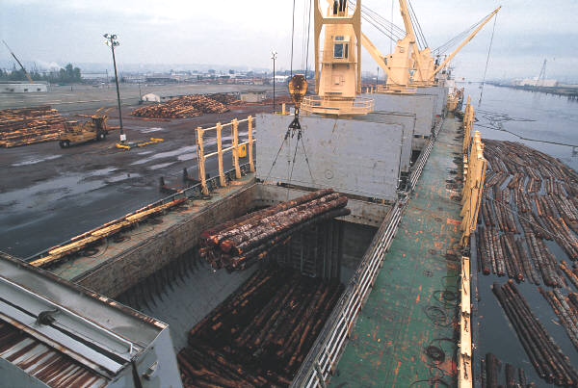
Horizontal and Vertical Standards
Vertical standards are specific only to a particular industry:
  Welding (1910.252)
Standards that apply to the special industries covered in Subpart R of 1910 are examples of vertical standards, these include:
  Pulp, paper, and paperboard mills (1910.261)
  Textiles (1910.262)
  Sawmills (1910.265)
  Logging operations (1910.266)

Slide 20

General vs. Specific Standards
If a particular standard is specifically applicable to a condition, practice, means, method, operation, or process, it shall prevail over any different general standard which might otherwise be applicable to the same condition, practice, means, method, operation, or process.

Slide 21
Incorporation by Reference
Incorporation by reference was established by statute and allows Federal agencies to meet the requirement to publish regulations in the Federal register by referring to materials already published elsewhere.
Incorporation by reference has the force of law.

Slide 22
1910.6 Incorporation by Reference
The standards of agencies of the U.S. Government, and organizations which are not agencies of the U.S. Government which are incorporated by reference in this part, have the same force and effect as other standards in this part.
Only the mandatory provisions (i.e., provisions containing the word "shall" or other mandatory language) of standards incorporated by reference are adopted as standards under the Occupational Safety and Health Act.

Slide 23
1910.6 Incorporation by Reference
The materials listed in 1910.6 in paragraphs (b) through (w) of this section are standards incorporated by reference in the corresponding sections noted

Slide 24

Standards Development
OSHA can begin standards-setting procedures on its own initiative, or in response to petitions from other parties, including:
Secretary of Health and Human Services (HHS);
National Institute for Occupational Safety and Health (NIOSH);
U.S. Environmental Protection Agency (EPA);

Slide 25
Standards Development
Additionally:
State and local governments;
Standards-producing organization;
Employer or labor representatives, or;
Any other interested person.

Slide 26

Standards Adoption
When OSHA plans to propose, amend, or revoke a standard, it publishes it’s intentions in the Federal Register
  Notice of Proposed Rulemaking
  Request for Information
Provides time for the public to respond
Sets up public hearings

Slide 27

Standards Adoption
An "Advance Notice" or a "Request for Information" is used, when necessary, to solicit information that can be used in drafting a proposed standard
Usually provide 60 days or more for the public to respond
Public hearings are then scheduled.

Slide 28

Standards Adoption
After the close of the comment period and public hearing, if one is held, OSHA must publish in the Federal Register:
  The full, final text of any standard amended or adopted and
  The date it becomes effective,
  An explanation of the standard and the reasons for implementing it.

Slide 29

Appealing a Standard
May file a petition (within 60 days of the rule's promulgation) for judicial review of the standard with the U.S. Court of Appeals for the circuit in which the objector lives or has his or her principal place of business.
Filing an appeals petition will not delay the enforcement of a standard, unless the Court of Appeals specifically orders it.

Slide 30

Advisory Committees
If OSHA determines that a specific standard is needed, any of several advisory committees may be called upon to develop specific recommendations.
There are two standing committees
All advisory committees must have members representing management, labor and state agencies.
H&S professions and the general public also may be represented.

Slide 31

Advisory Committees
National Advisory Committee on Occupational Safety and Health (NACOSH), which advises the Secretary of HHS and to the Secretary of Labor on matters regarding administration of the Act.
Advisory Committee on Construction Safety and Health, advises the Secretary of Labor on formulation of construction safety and health standards and other regulations.

Slide 32

Title 29 Chapter XVII
Title 29, Chapter XVII is set aside for OSHA
The regulations are broken down into Parts
Part 1910, contains the “General Industry” Regulations
Each Part is then broken into major Subparts

Slide 33
Part 1910 Major Subparts
Subpart D - Walking and Working Surfaces
Subpart E - Exit Routes, Emergency Action Plans, and Fire Prevention Plans
Subpart F - Powered Platforms
Subpart G - Occupational Health and Environmental Control
Subpart H - Hazardous Materials
Subpart I - Personal Protective Equipment

Slide 34
Part 1910 Major Subparts
Subpart J - General Environmental Controls
Subpart K - Medical and First Aid
Subpart L - Fire Protection
Subpart M - Compressed Gas
Subpart N - Materials Handling
Subpart O - Machinery and Machine Guarding
Subpart P - Tools

Slide 35
Part 1910 Major Subparts
Subpart Q - Welding, Cutting & Brazing
Subpart R - Special Industries
Subpart S - Electrical
Subpart T - Commercial Diving
Subpart Z - Toxic and Hazardous Substances
Each Subpart is then broken down into Sections

Slide 36
Subpart D Walking-Working Surfaces
Let’s look at the sections that make up Subpart D:
1910.21 Definitions
1910.22 General Requirements
1910.23 Guarding Floor and Wall Openings and Holes
1910.24 Fixed Industrial Stairs
1910.25 Portable Wood Ladders
1910.26 Portable Metal Ladders
1910.27 Fixed Ladders
1910.28 Safety Requirements for Scaffolding
1910.29 Manually Propelled Mobile Ladders and Scaffolds
1910.30 Other Working Surfaces
1910.31 Sources of Standards
1910.32 Standards Organizations

Slide 37
Reading Standards
29 CFR 1910.110(b)(13)(ii)(b)(7)(iii)
29 United States Code Title
CFR Code of Federal Regulations
1910 Part - Part 1910 covers General Industry
110 Section Number {Section 110 falls under Subpart H; Hazardous Materials}

Slide 38
Reading Standards
29 CFR 1910.110(b)(13)(ii)(b)(7)(iii)
Following the Section number are Major Paragraphs, they are denoted with parentheses and a lower case alphabetical
(b) Major Paragraph; “Basic Rules”
(13) Paragraph Subsection; “LP-Gas in buildings”.
Arabic Number
Lower Case Alphabetical

Slide 39
Reading Standards
29 CFR 1910.110(b)(13)(ii) (b)(7)(iii)
The next subdivision uses lower case roman numeral
After this the paragraph number sequence begins again as before only this time using italics
(After 1979 the fourth set of parentheses uses a capital letter instead of a small case italicized)
Lower Case Roman

Slide 40
Color Coding
Pink - Full Column
Width
Code of
Fed. Reg.
Title
Part
Section
29 CFR 1910 .110 (b)(13)(ii) (b)(7)(iii)
Yellow - Full Column
Width
Dot Yellow - Arabic Number
A good way to find standards more quickly is to color code your book

Slide 41
Hazard Violation Workshop- Introduction
An essential skill for health and safety personnel is the ability to readily identify potential violative conditions in the workplace
The materials presented will provide an opportunity to develop your skills in this important area
The skills you develop will be useful for conducting safety audits and for safety committee activities

Slide 42

Hazard Violation Workshop- Introduction
An essential skill for health and safety personnel is the ability to readily identify potential violative conditions in the workplace
The materials included in the hazard violation workshop will provide an opportunity to develop your skills in this important area
The skills you develop will be useful for conducting safety audits and for safety committee activities

Slide 43
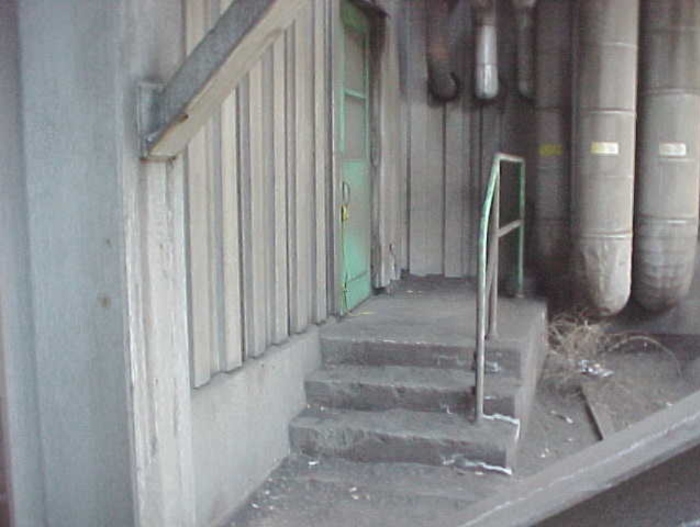

Hazard Violation Workshop- Introduction
Example: An exit door is blocked from the outside

Slide 44


The
End

